Slide 1
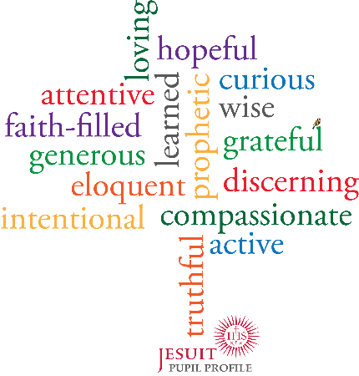
loving
hopeful
curious
attentive
&
wise
faith-filled
learned
prophetic
grateful
generous
eloquent
discerning
intentional
compassionate
active
truthful
Notes:
7 Curious & Active

